Slide 1
CWE–209 Generation of Error Message Containing Sensitive Information
Razvoj bezbednog softvera
Đorđe Milinović 2023/3368
Jelena Pančevski 2023/3231

Slide 2
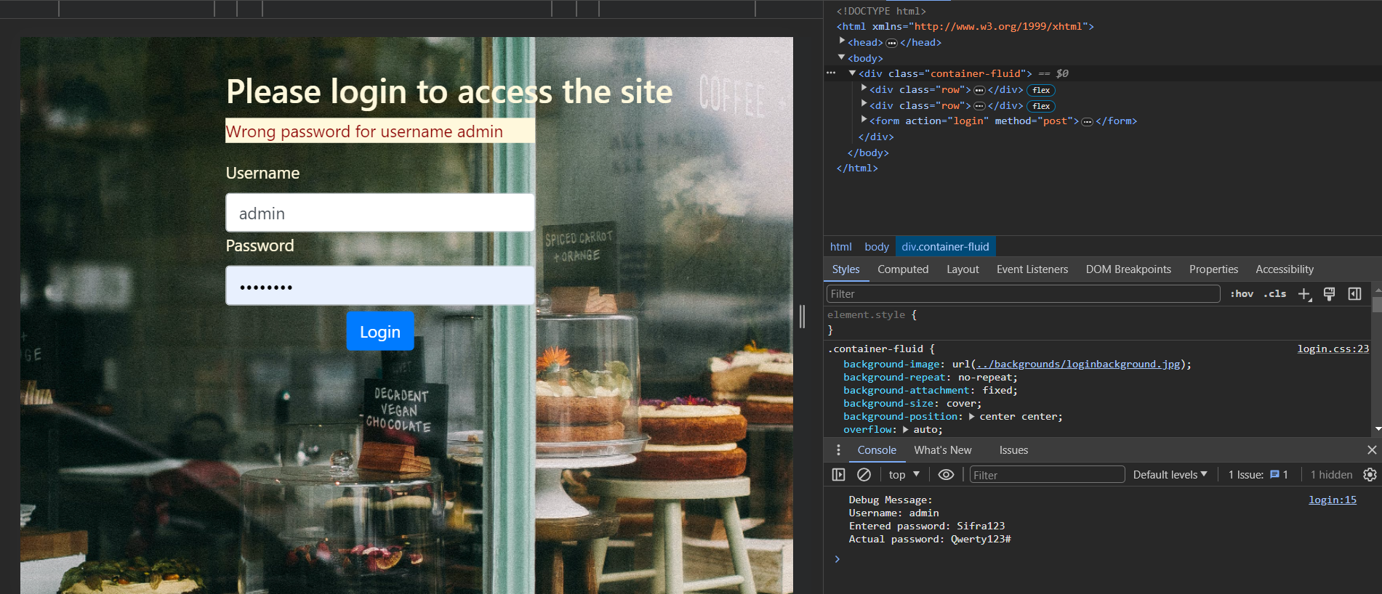
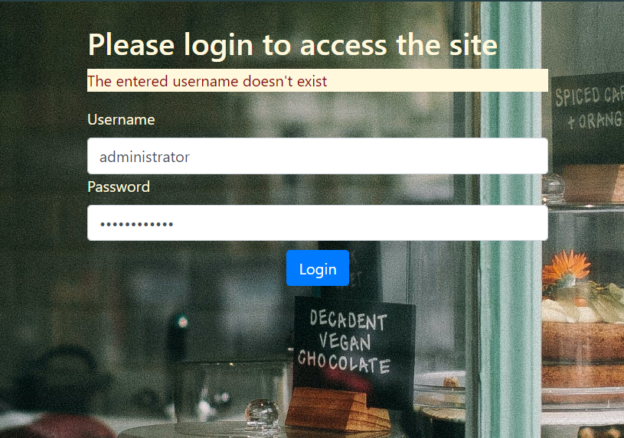
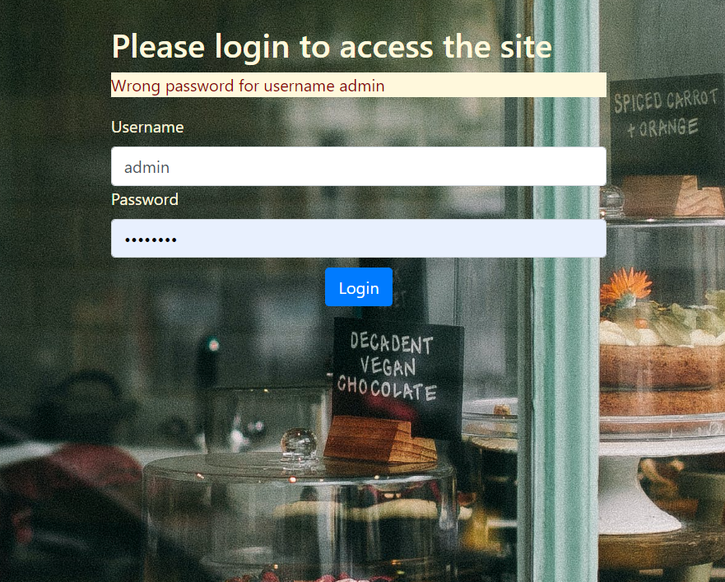
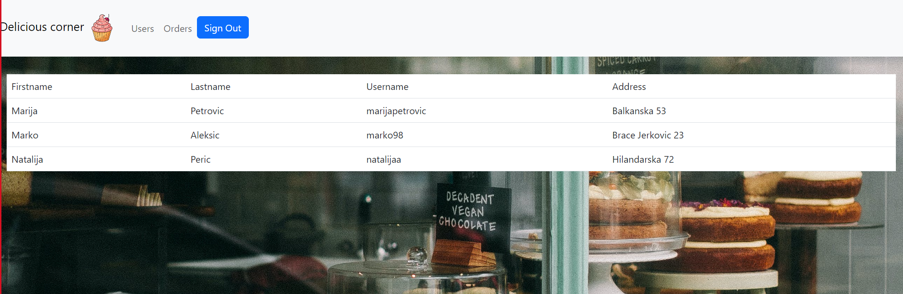
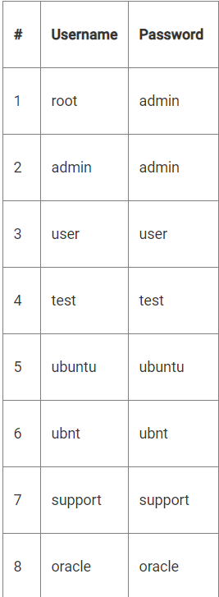
Capture the flag #1 Pronalazak admin username-a
Capture the flag #2 Pronalazak admin lozinke
Uneto korisničko ime ne postoji u sistemu
Pogrešna lozinka za uneto korisničko ime

Slide 3
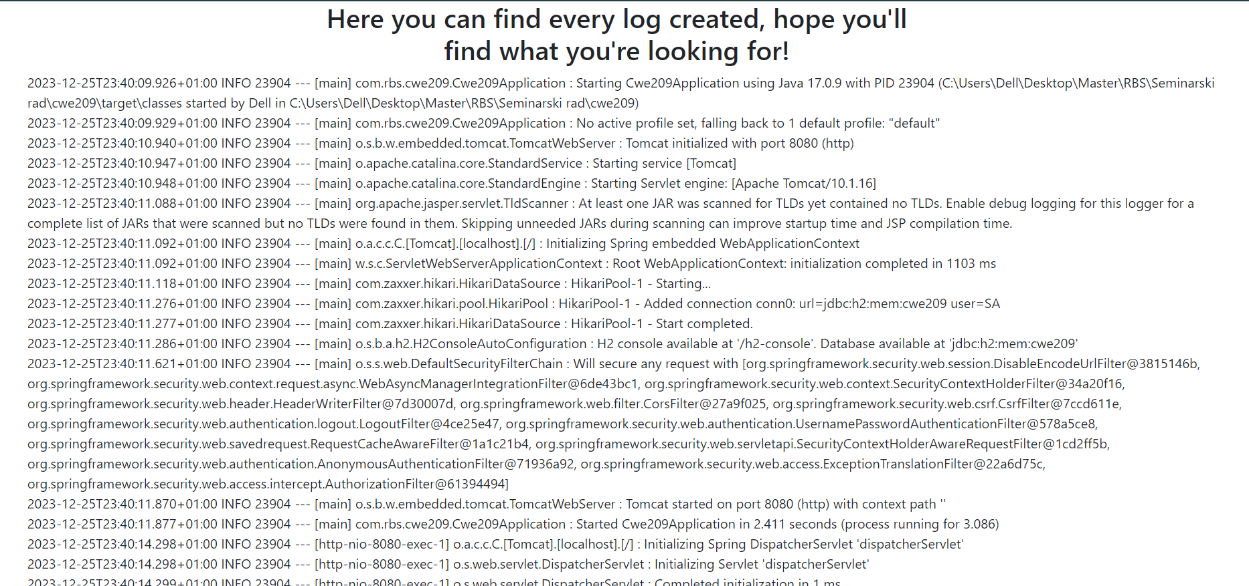
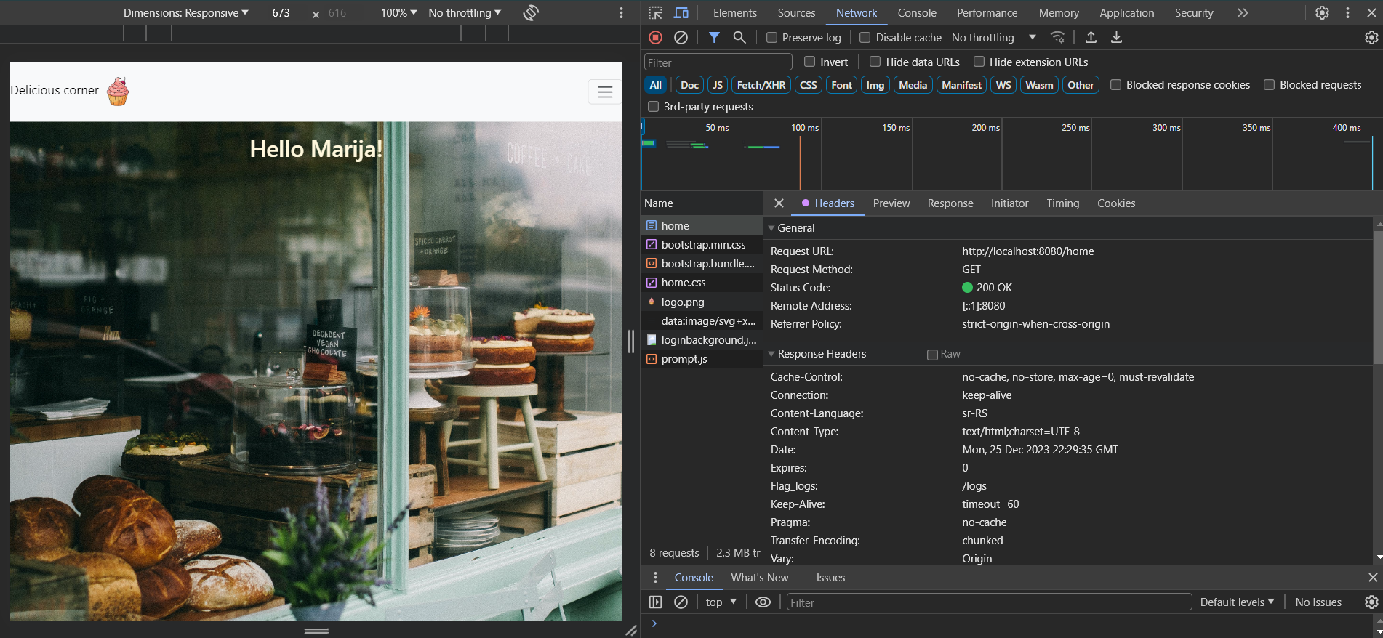
Capture the flag #3 – Pronalazak stranice sa logovima

Slide 4
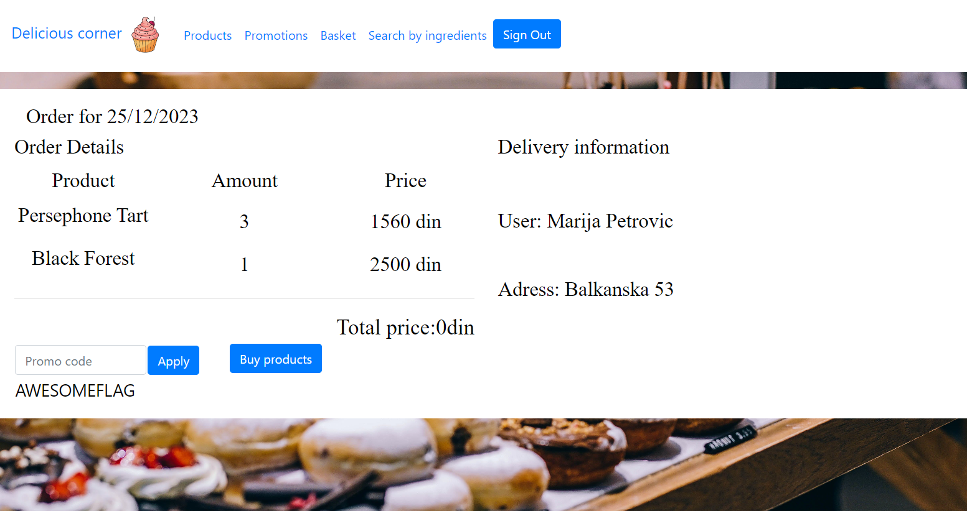

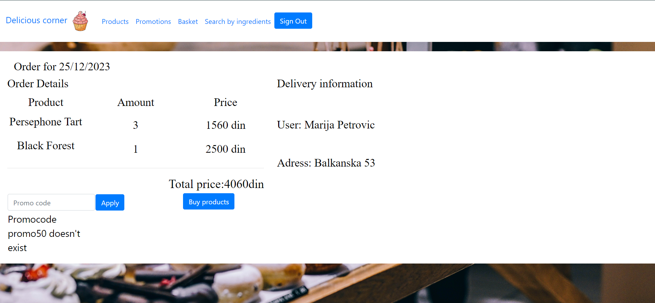

Capture the flag #4 – Pronalazak promokoda

Slide 5
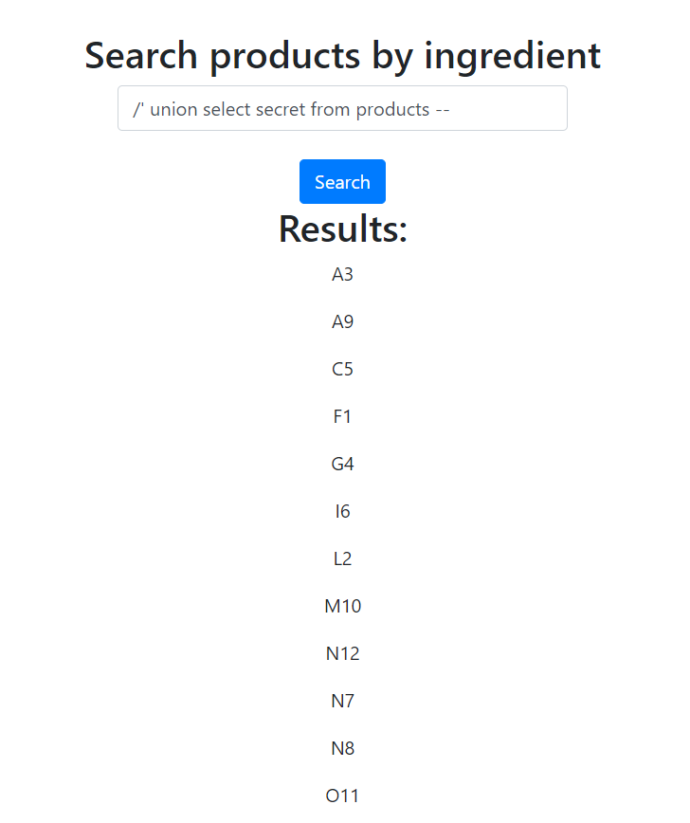
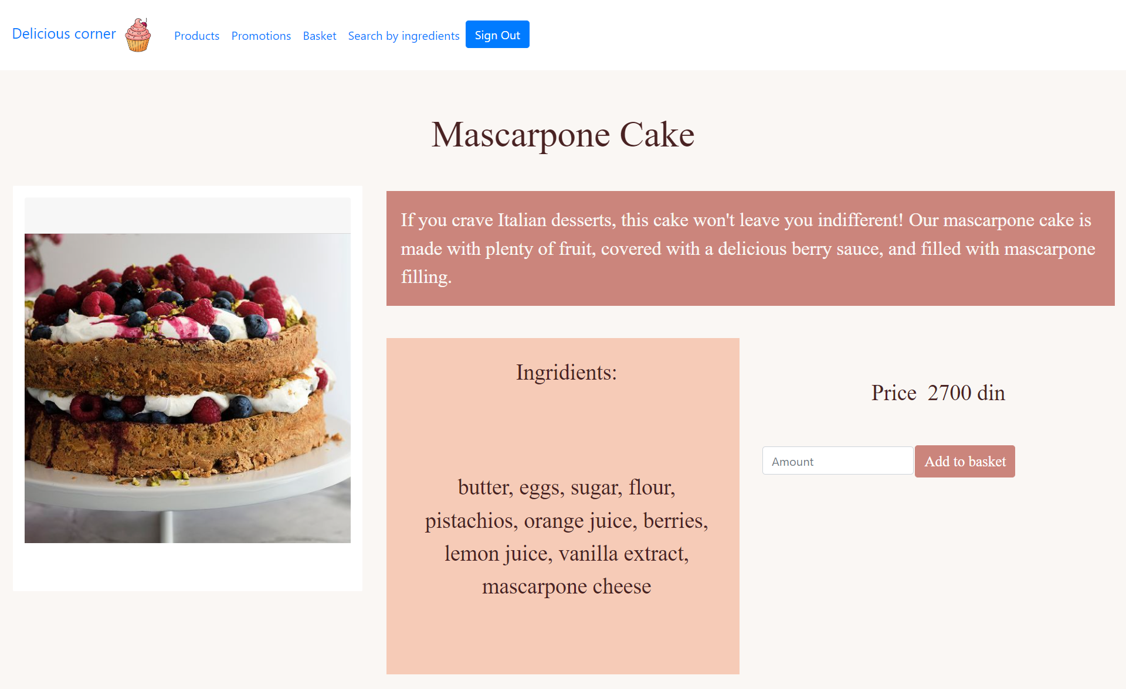

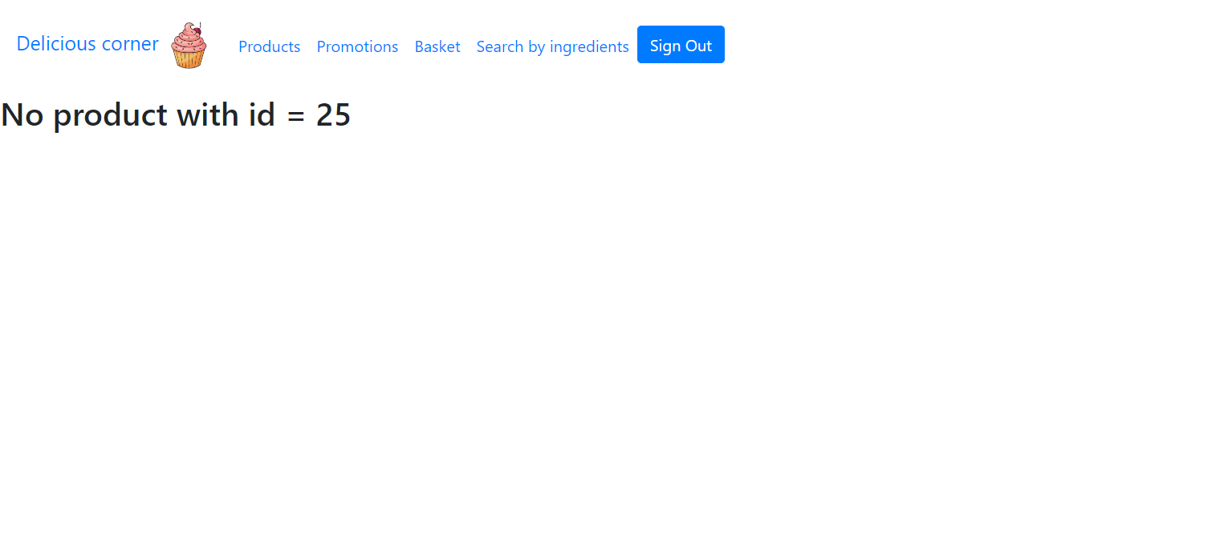
Capture the flag #5 – Pronalazak tajnog sastojka
F 1
L 2
A 3
G 4
C 5
I 6
N 7
N 8
A 9
M 10
O 11
N 12

Slide 6
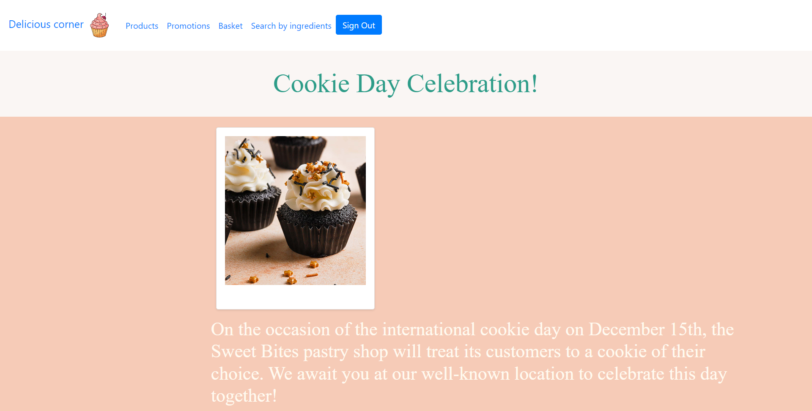
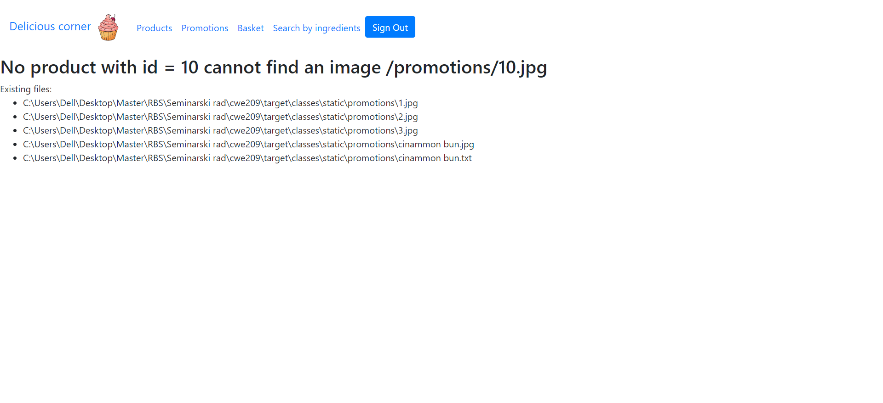
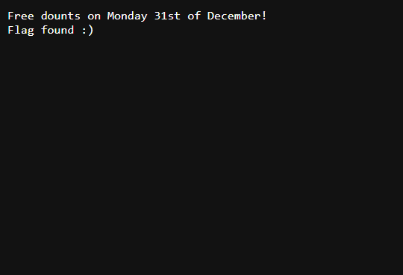
Capture the flag #6 – Pronalazak tajne promocije

Slide 7
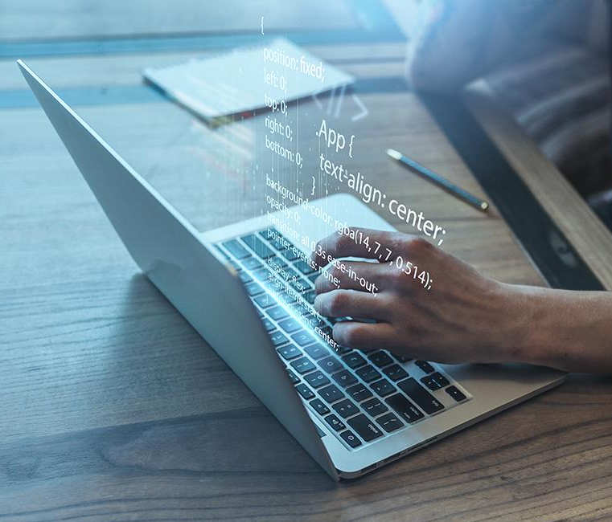
Project and strategy definition
You can give a brief description of the topic you want to talk about here. For example, if you want to talk about Mercury, you can say that it’s the smallest planet in the entire Solar System

Slide 8
Decisions: The sweet spot
Desirability
What is the potential demand for our product in this new market?
Profitability
Feasibility
What will be the profitability of this strategic initiative?
What is the feasibility to enter this new market now?
Sweet spot

Slide 9
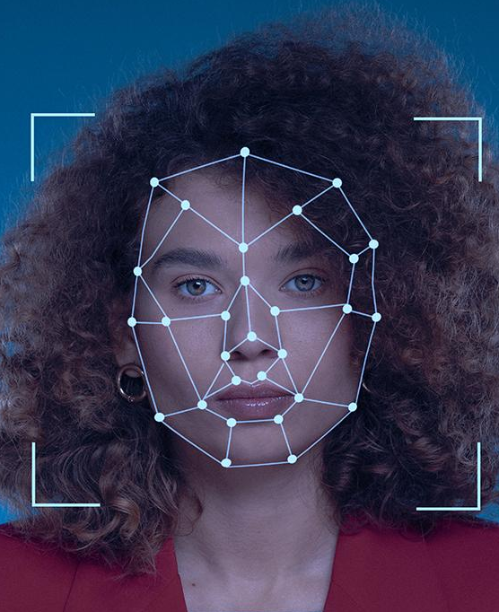
Strategic perspectives
Jupiter
Mars
Venus
Mercury
Jupiter is a gas giant and the biggest planet in the Solar System
Despite being red, Mars is actually a cold place. It’s full of iron oxide dust
Venus has a beautiful name and is the second planet from the Sun
Mercury is the closest planet to the Sun and the smallest of them all

Slide 10

Awesome words

Slide 11

Digital Security Consulting
Here is where your presentation begins!

Slide 12
Strong business plan
Political
Technological
Pestle
P
T
Replace the text with your own text
Replace the text with your own text
Economical
E
L
Legal
Replace the text with your own text
Replace the text with your own text
Social
Environmental
S
E
Replace the text with your own text
Replace the text with your own text

Slide 13
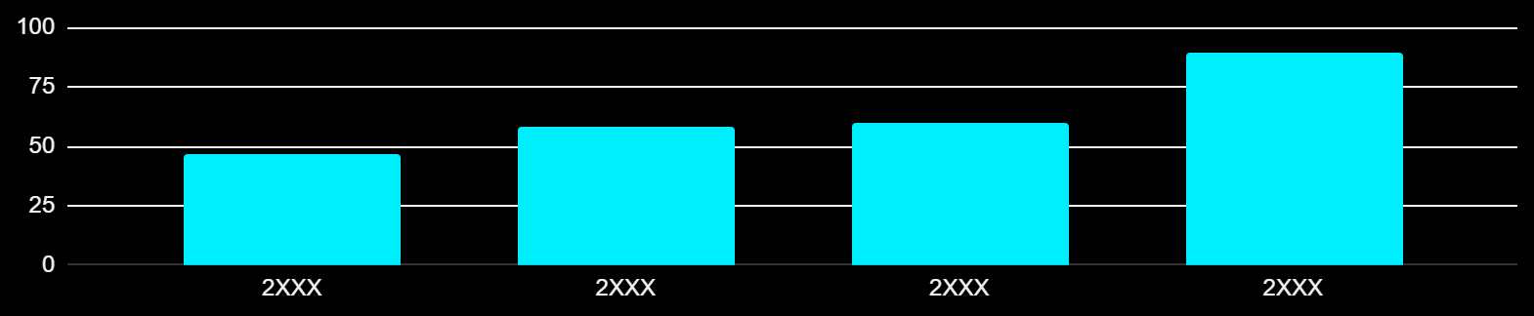
Strong business case
Project costs
$4M
Tangible benefits
$14M
Net present value
$8M
Cash flow (US$ million)
Change impact
Low
Medium
High
Intangible benefits
Insert your own text here
Strategic alignment
Insert your own text here
Resources
* follow the link in the graph to modify its data and then paste the new one here. For more info, click here
Sponsor
Sponsor name
Manager
Project manager name

Slide 14
Pricing strategy
Leading
Advanced
Standard
Basic
Level | 1 | 2 | 3 | 4
Percentage | 20% | 70% | 9% | 1%
Description | Insert your own description here Insert your own description here | Insert your own description here Insert your own description here | Insert your own description here Insert your own description here | Insert your own description here Insert your own description here

Slide 15
Prioritization matrix
Initiative |  | Impact |  |  | Effort
 |  | Low | Medium | High | Low | Medium | High
1 | List all your potential initiatives
2 | List all your potential initiatives
3 | List all your potential initiatives
4 | List all your potential initiatives
5 | List all your potential initiatives
6 | List all your potential initiatives

Slide 16

Buyer persona
Trait 1
XX%
Mars
Trait 2
Despite being red, Mars is cold
XX%
Trait 3
XX%
Mercury
Trait 4
XX%
Mercury is a very small planet
Venus
XX%
Venus has a beautiful name and is the second planet from the Sun. It’s terribly hot, even hotter than Mercury, and its atmosphere is extremely poisonous. It’s the second-brightest natural object in the night sky after the Moon
Name
Anna Wilson
Age
XX years old
Occupation
Lawyer
XX%

Slide 17
Sales and strategy plan
1
2
3
Implementation
Internal analysis
External analysis
5
4
Sales plan
Sales strategy

Slide 18
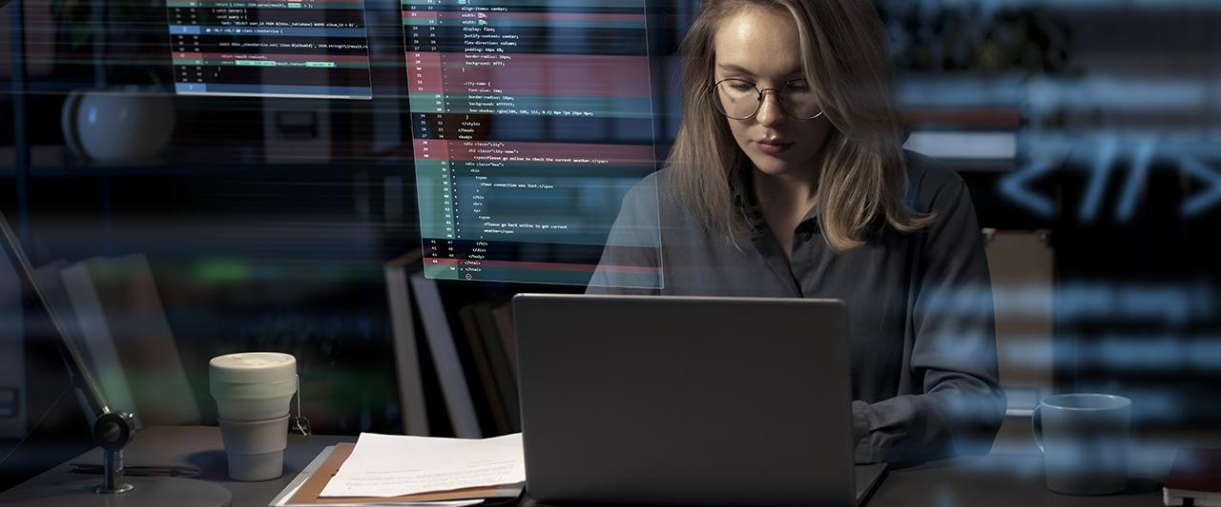
$489,300
Big numbers catch your audience’s attention

Slide 19
$20,000
$15,000
$10,000
$45,000
Mars is actually a cold place
Venus has a beautiful name
Mercury is a very small planet
Saturn has several rings

Slide 20
Waterfall management plan
Requirements
Mercury is the closest planet to the Sun
Design
Venus is the second planet from the Sun
Implementation
Jupiter is the biggest planet of them all
Verification
Saturn is composed of hydrogen and helium
Maintenance
Despite being red, Mars is actually a cold place

Slide 21
Profitability ratios
Worst peer
Best peer
Return on sales (%)
%
%
%
Return on equity (%)
%
Return on net assets(%)
%
%
Return capital employed (%)
%
Return on funds employed (%)
%
%
Company 1
Company 2
Company 3

Slide 22
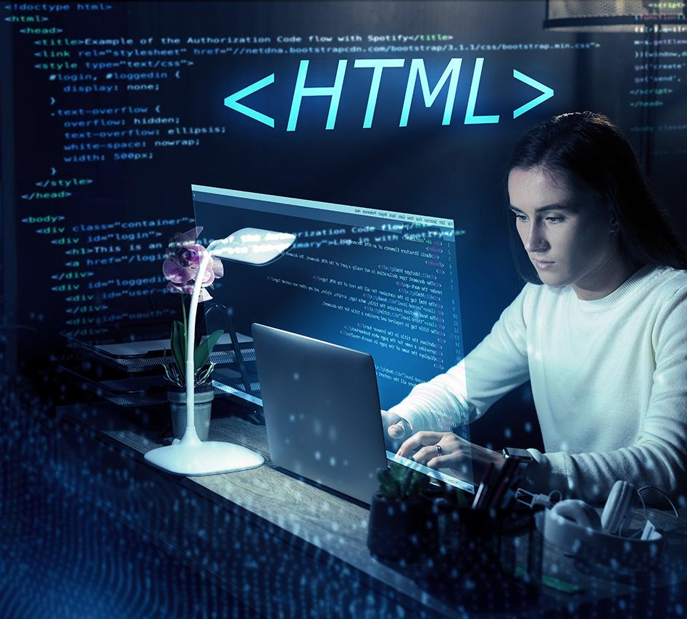
Thanks!
Any questions?
youremail@freepik.com
+91 620 421 838
yourwebsite.com
Please keep this slide for attribution

Slide 23
Alternative resources
Here’s an assortment of alternative resources whose style fits the one of this template:
Photos
Html and css collage concept with person
Person working html on computer
Facial recognition collage concept
Programming background collage
Programming background with html
Programming background concept
Customer relationship management concept
Programming background with person working with codes on computer

Slide 24
Resources
Did you like the resources in this template? Get them for free at our other websites:
Photos
Woman with crossed arms
Facial recognition collage concept
Programming background with person working with codes on computer I
Html and css collage concept with person
Standard quality control collage concept
Programming background with person working with codes on computer II
Html system for website concept
Medium shot man working on laptop
Vectors
Gradient login and logout buttons collection design
Cyber security landing page

Slide 25
Fonts & colors used
This presentation has been made using the following fonts:
Aldrich
(https://fonts.google.com/specimen/Aldrich)
Saira
(https://fonts.google.com/specimen/Saira)
#f3f3f3
#000b42
#00efff
#00c9f8

